Slide 1
Calculator Application Project
Shaik Gulnaz Intern

Slide 2
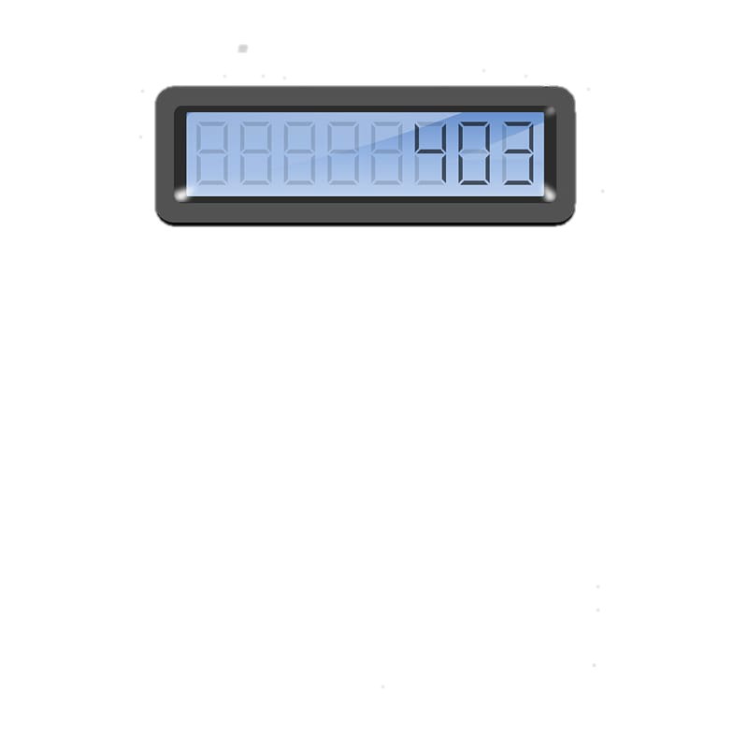
Introduction
This project involves the creation of a calculator application.
The purpose of this project is to develop a functional and user-friendly calculator that can perform basic arithmetic operations.

Slide 3
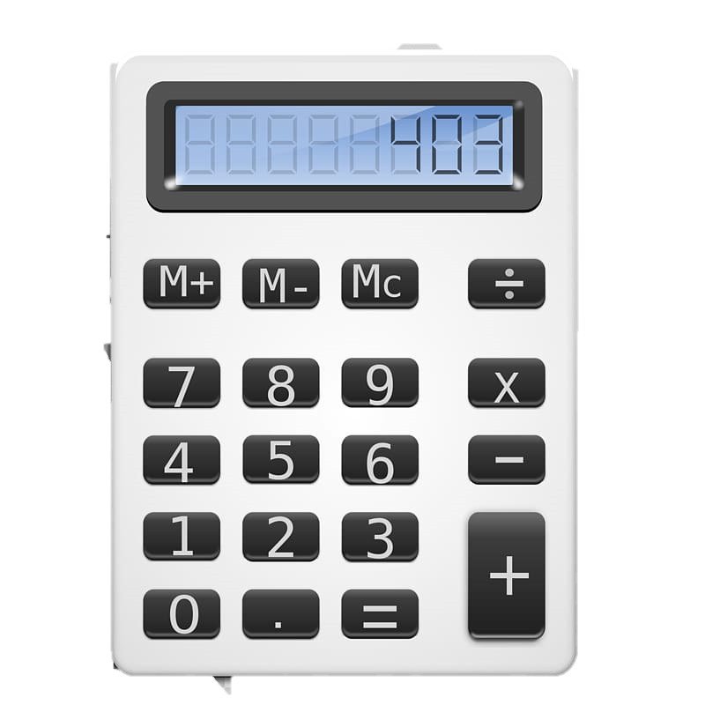
Working - Overview
The calculator application allows users to perform operations such as addition, subtraction, multiplication, and division.
Key features include a user-friendly interface, error handling for invalid inputs, and real-time calculation display.

Slide 4
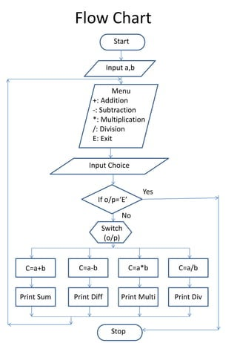
Working - User Interface
The user interface includes buttons for digits (0-9) and operations (+, -, *, /).
There is also a display area to show the input and the result of the calculation.

Slide 5
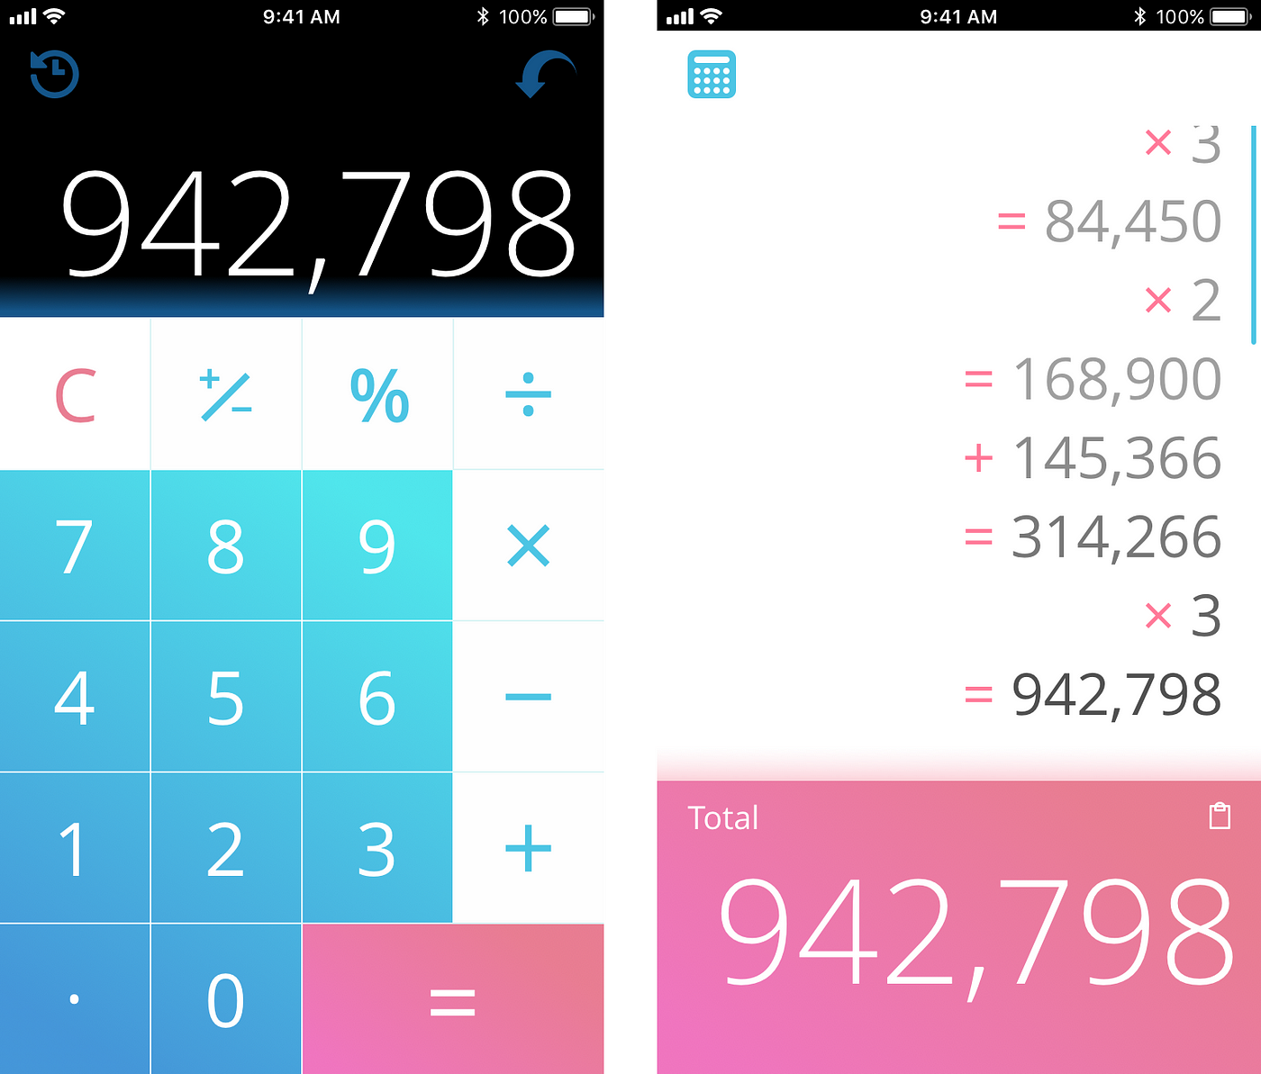
Working - Operations Handling
When a user clicks a button, the corresponding value is captured and stored.
The application performs the calculation based on the selected operation and displays the result in real-time.

Slide 6
Uses
This calculator application can be used for:
- Basic arithmetic calculations
- Educational purposes
- Everyday use for quick calculations

Slide 7
Algorithm - Overview
The algorithm used in the calculator application involves:
1. Taking user input for numbers and operation.
2. Performing the calculation based on the selected operation.
3. Displaying the result in real-time.

Slide 8
Algorithm - Pseudocode
Pseudocode for the algorithm:
1. Initialize variables to store user inputs and result.
2. Capture input when a button is clicked.
3. Perform the arithmetic operation based on the input.
4. Display the result.

Slide 9
How to Build - Design
To build the calculator application, follow these steps:
1. Design the user interface with buttons for digits and operations, and a display area for results.

Slide 10
How to Build - Implementation
2. Implement event handlers for button clicks to capture user input and perform calculations.
3. Use a programming language like VBA, JavaScript, or Python to code the logic for arithmetic operations.

Slide 11
How to Build - Testing
4. Test the application thoroughly to ensure accurate calculations and error handling.

Slide 12
Conclusion
This project successfully developed a functional calculator application.
Future improvements could include advanced mathematical functions and a more intuitive user interface.

